Slide 1
This is Modern #8
You should check your work, fix your work, write reminder notes if you need reminder notes.
Make note of anything you have questions on and EMAIL me with them.

Slide 2
Multiple Choice

Slide 3
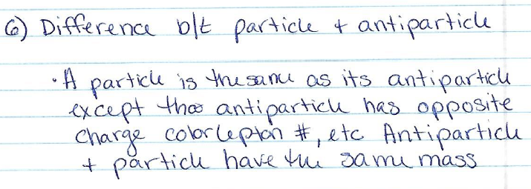
Concept

Slide 4
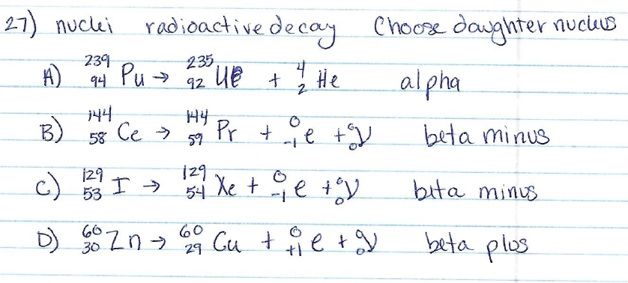
Problem

Slide 5
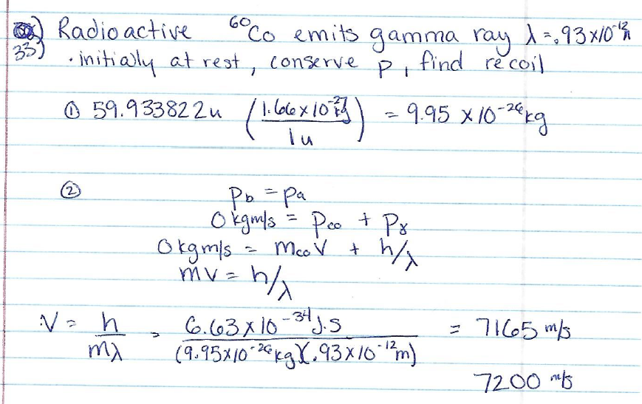
Problem

Slide 6
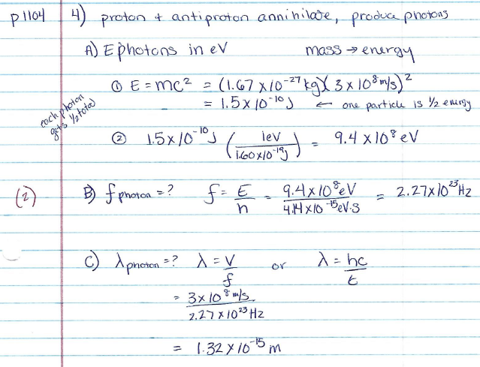
Problem

Slide 7
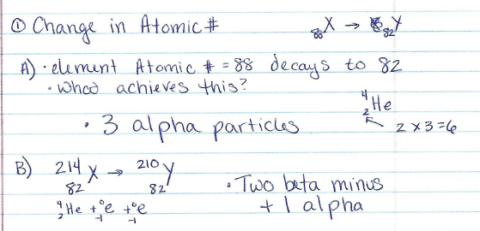
Online 1 – Change in Atomic #

Slide 8
Online 2 – Radioactive Decay

