Slide 1
This is Modern #2
You should check your work, fix your work, write reminder notes if you need reminder notes.
Make note of anything you have questions on and EMAIL me with them.

Slide 2
Multiple Choice and Concept

Slide 3
Problems

Slide 4
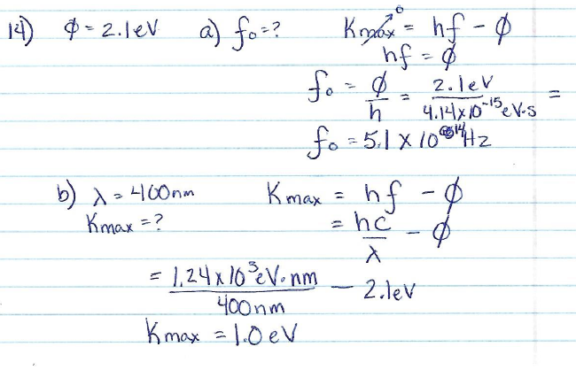
Problems

Slide 5
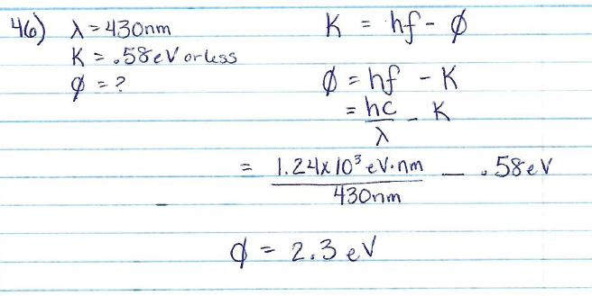
Problems

Slide 6
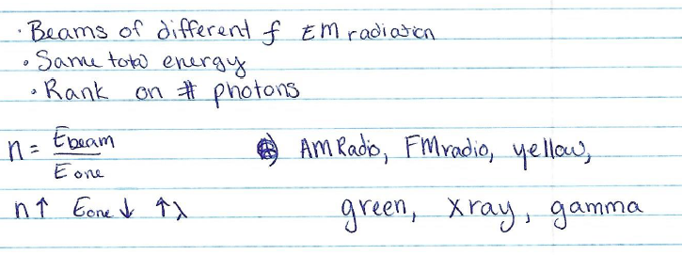
Online

