Slide 1
These are pages 10 – 11. It is a continuation of the Regents level information about refraction.
EMAIL ME if you have questions.

Slide 2
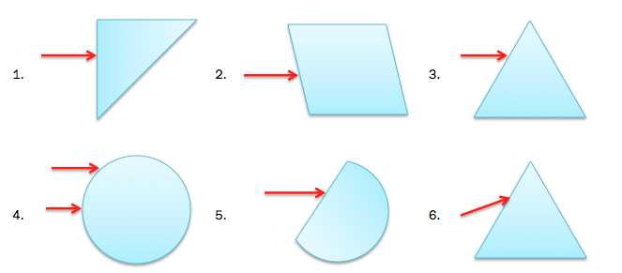
Sketch the path of the light rays through each glass figure and out the other side. Hint – draw a normal line at each interface.
Draw the normal line perpendicular to SURFACE, not the ray.
Bend TOWARD in material. Bend AWAY in air.

Slide 3
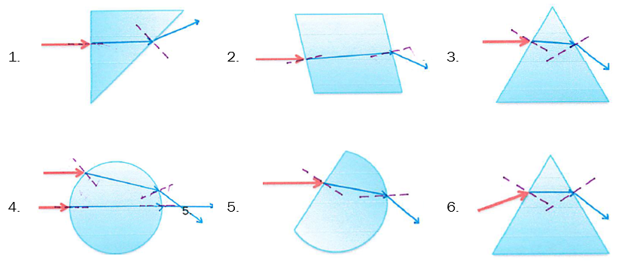
Sketch the path of the light rays through each glass figure and out the other side. Hint – draw a normal line at each interface.

Slide 4
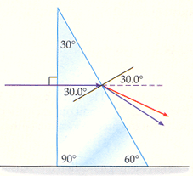
The prism below has an index of refraction of 1.55. Calculate and sketch the path of the light ray as travels through the prism.
50°

Slide 5
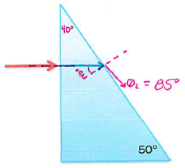
The prism below has an index of refraction of 1.55. Calculate and sketch the path of the light ray as travels through the prism.
50°

Slide 6
Sketch the path of the light ray if the index of refraction of the figure is less than that of the surrounding media.

Slide 7
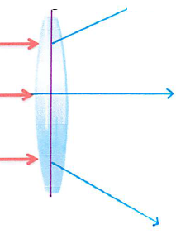
Sketch the path of the light ray if the index of refraction of the figure is less than that of the surrounding media.
Acts like diverging lens

Slide 8
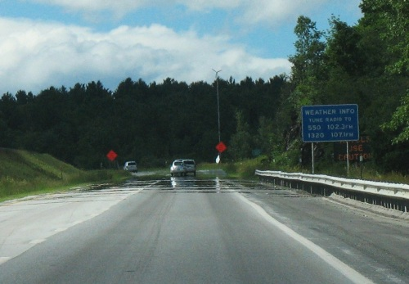
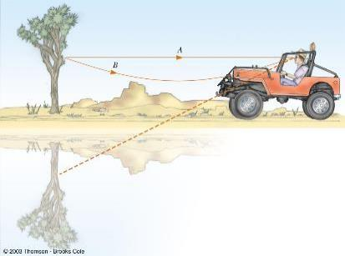
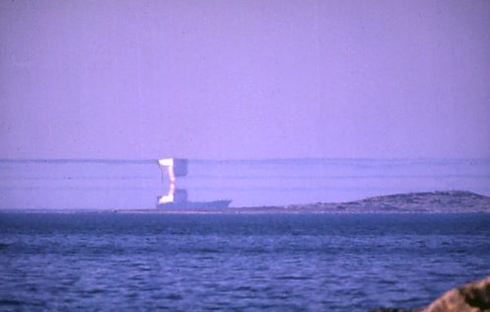
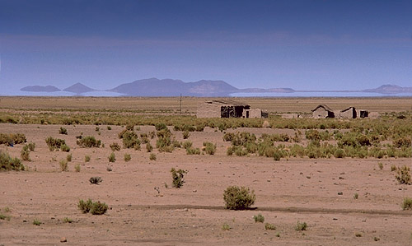
Refraction Effects
Because light bends going from the HOT air right above the pavement to the COOL air above that, we can see reflects in pavement.

Slide 9
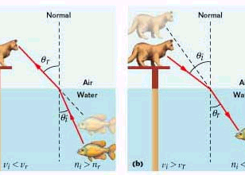
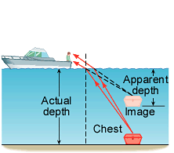
Depth Perception
Because light bends going from water to air, the apparent depth is different from the actual depth.

Slide 10
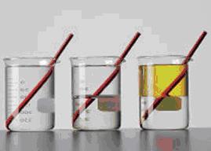
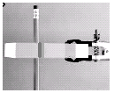
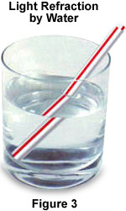
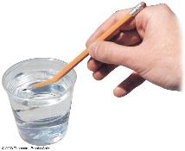
A Broken Pencil!!!
MAGIC!

Slide 11
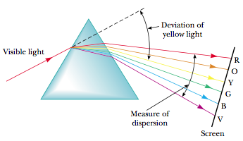
Dispersion of Light
Red:
Fastest
Lowest n
Bends least
Violet:
Slowest
Highest n
Bends most
Dispersion – the separating of white light into its component colors due to refraction

Slide 12
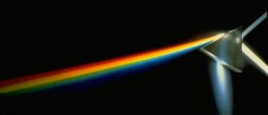
Dispersion of Light
Explanation:
each frequency of light has a slightly different index of refraction
so each frequency bends by a different amount

Slide 13
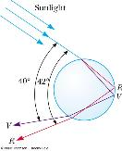
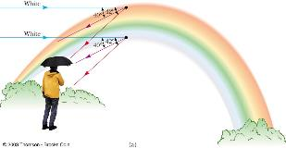
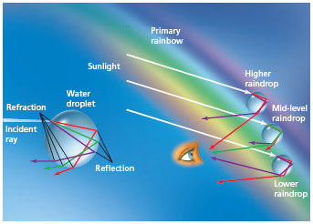
Dispersion
Rainbows Caused by Dispersion
Rainbows are due the sunlight coming from over an observer’s shoulder being refracted by water droplets in the air. Each color is refracted by a different amount with the result being the dispersion of the light into its component colors.

Slide 14
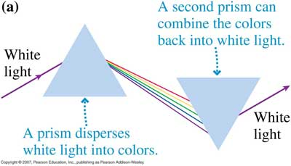
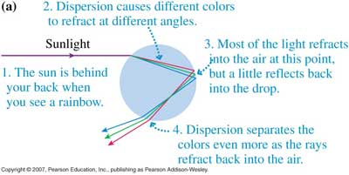
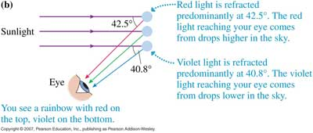
Dispersion

Slide 15
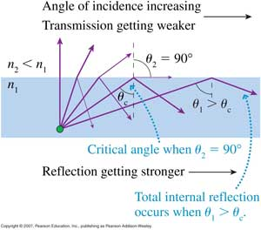
Total Internal Reflection
Conditions for Total Internal Reflection:
ray of light must be traveling from the more optically dense to the less optically dense medium
ray must strike the boundary at an angle greater than the critical angle

Slide 16
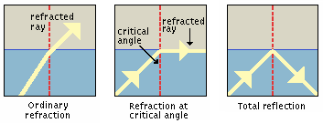
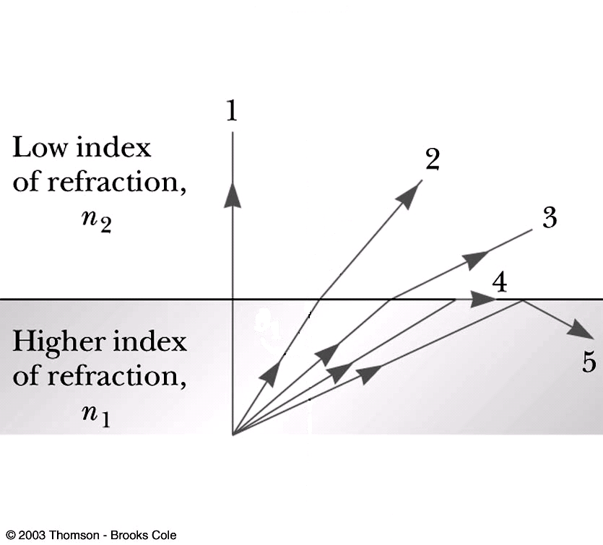
Total Internal Reflection
Critical Angle (θ_{c}) – angle of incidence for which the angle of refraction is 90°

Slide 17
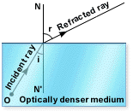
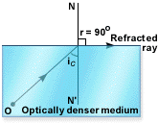
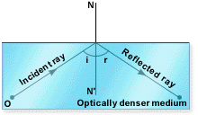
Critical Angle

Slide 18
Critical Angle
What is the critical angle as light exits from water into air?
What is the critical angle as light exits from water into crown glass?

Slide 19
Critical Angle
What is the critical angle as light exits from water into air?
What is the critical angle as light exits from water into crown glass?

